Slide 1
CellProfiler: An introduction to object detection, measurement and batch processing
Dr. Dominic Alibhai & Dr. Stephen Cross
Download “Example data” from https://goo.gl/rQpywN

Slide 2
Overview
Introduction to CellProfiler
What is it?
Looking at modularity and batch processing
Image and object models
Tour round the interface and key features
Live demo of example workflow
Detecting cells and bacteria
Counting the number of bacteria per cell
Drawing detected objects on the input image
Outputting results as images and spreadsheets

Slide 3
Where to get help
CellProfiler software
Detailed integrated documentation
Websites
http://cellprofiler.org/manuals/
http://cellprofiler.org/tutorials/
Wolfson Bioimaging!
Stephen: stephen.cross@bristol.ac.uk
Dom: da14205@bristol.ac.uk
Office: C31 (Biomedical Sciences Building)

Slide 4
What is CellProfiler?
Python
Open source
Batch processing
Drag and drop modules
Reads metadata
Extendable
Modular
Scalable
Grouping by condition, plate or experiment
Easily editable for new experiment
CellProfiler
Reproducible
Save pipelines
Flexible
Image data
Object data
Share pipelines
Intensity values
Shape parameters

Slide 5
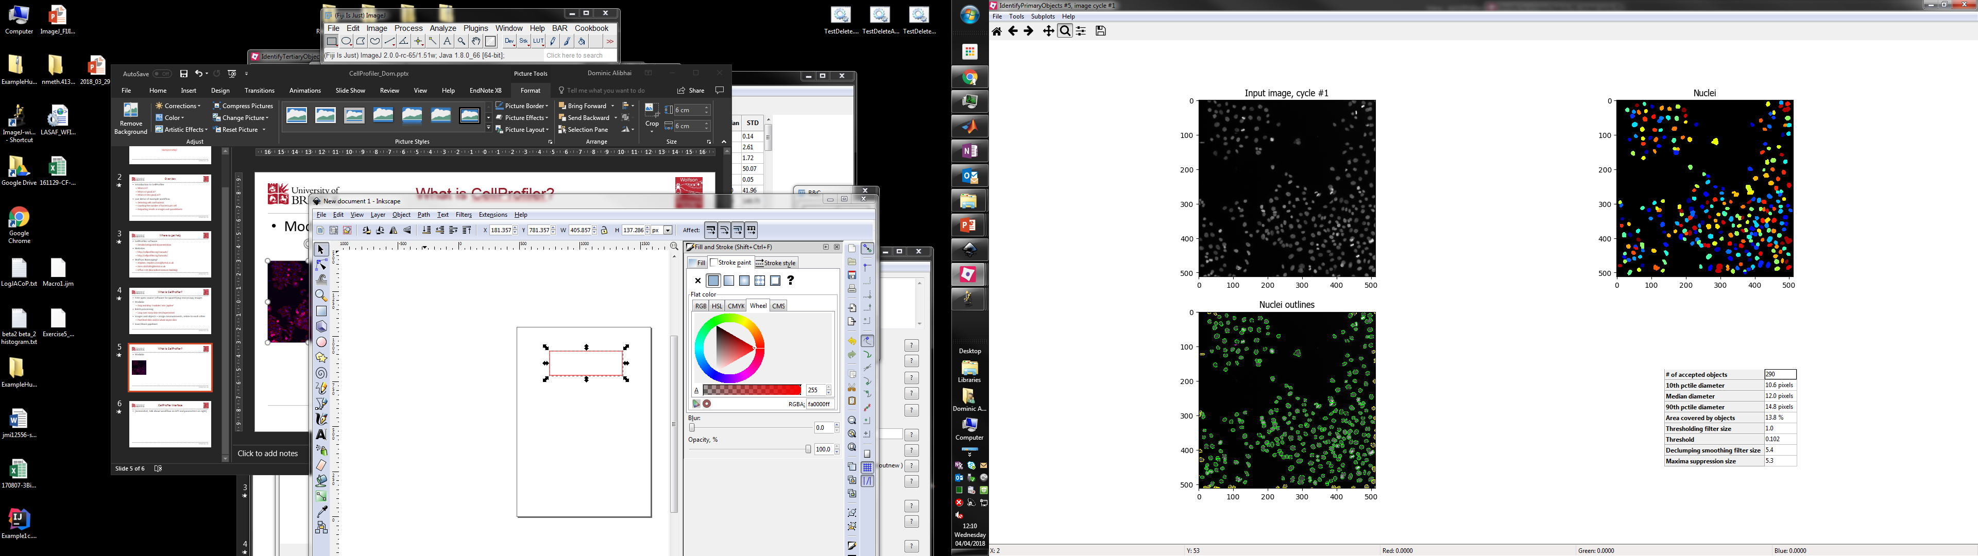

Modularity and batch processing
Loop over all images
OUT
IN
IN
OUT
OUT
IN
Load in images
Filter images
Find nuclei
Save images

Slide 6
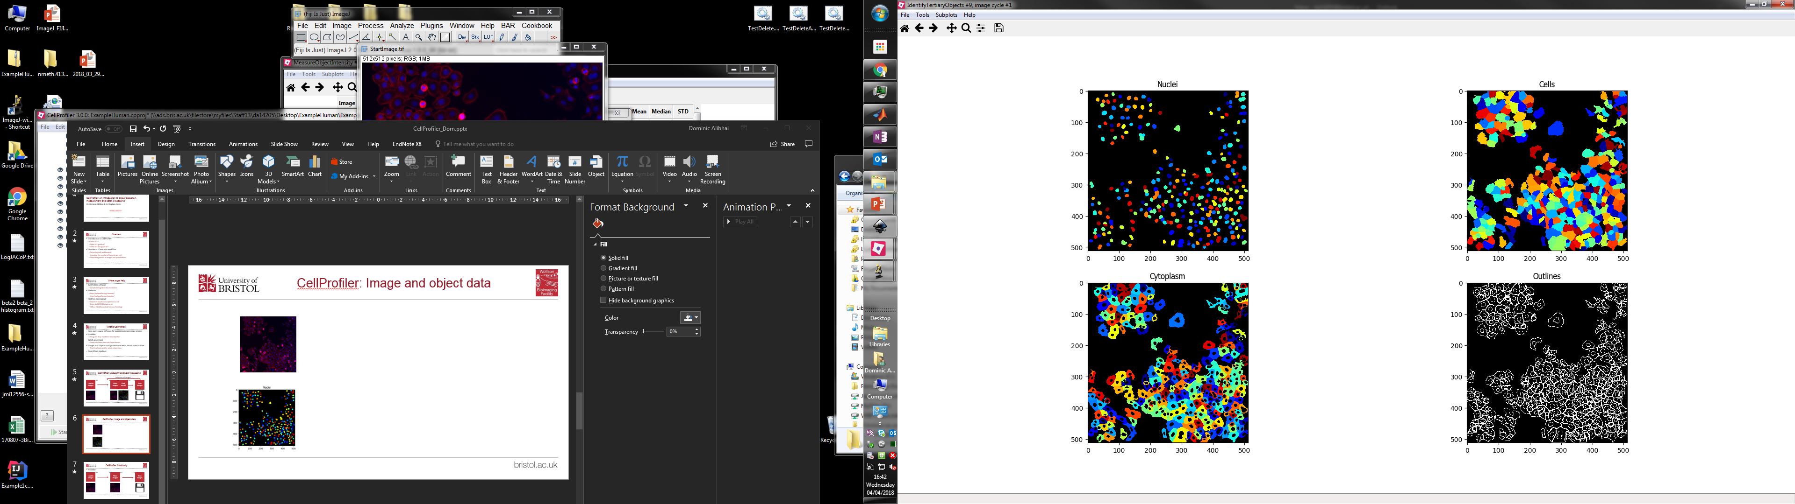
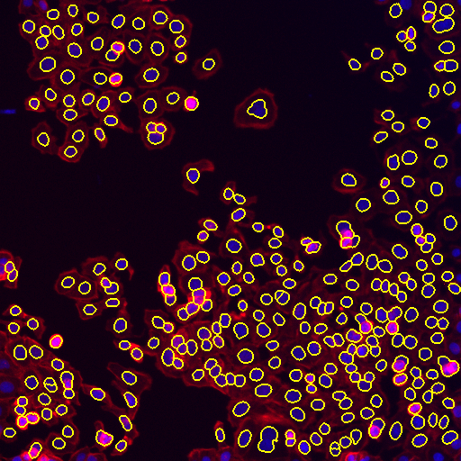
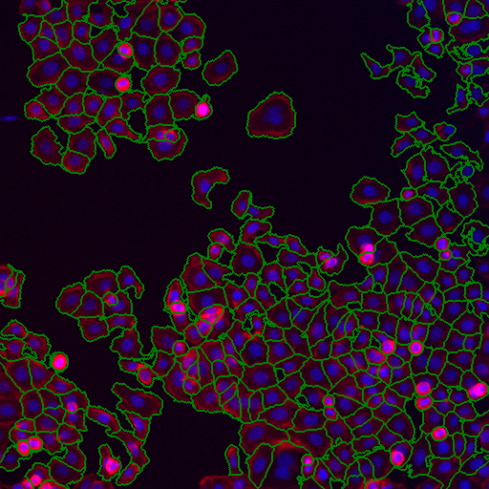
Image and object data
Image data
Object data
Pixel array, e.g 512 x 512
Intensity value per pixel
Pixels independent
Pixel array, e.g 512 x 512
Intensity value per object
Shape parameters per object
Pixels are grouped into objects

Slide 7
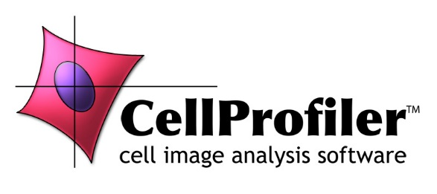

Quick note on CellProfiler3
CellProfiler is currently undergoing a major upgrade to version 3
Adds 3D native support
Currently not all modules work in 3D
Standard 2D modules should be fine

Slide 8
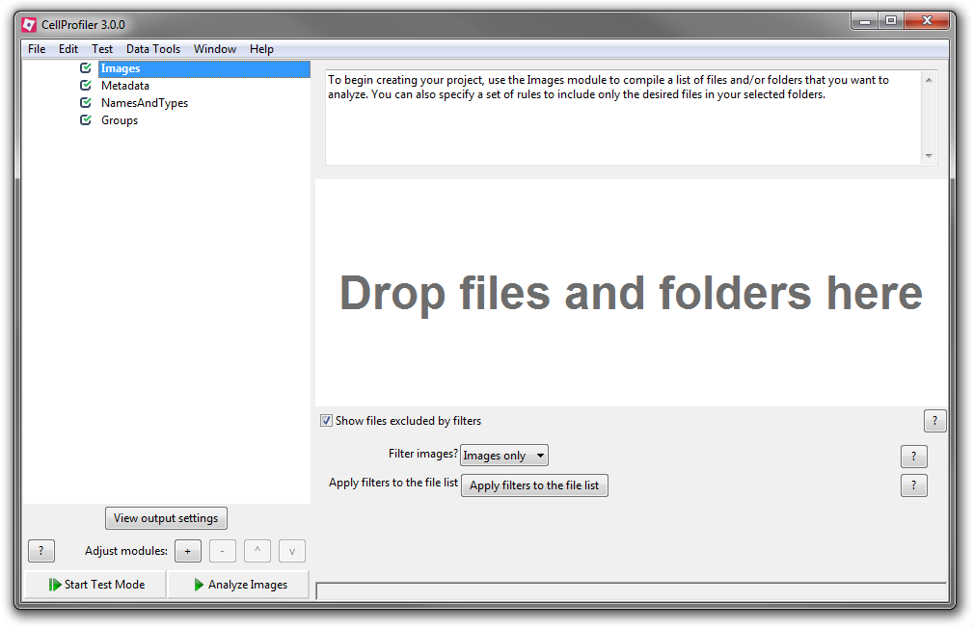
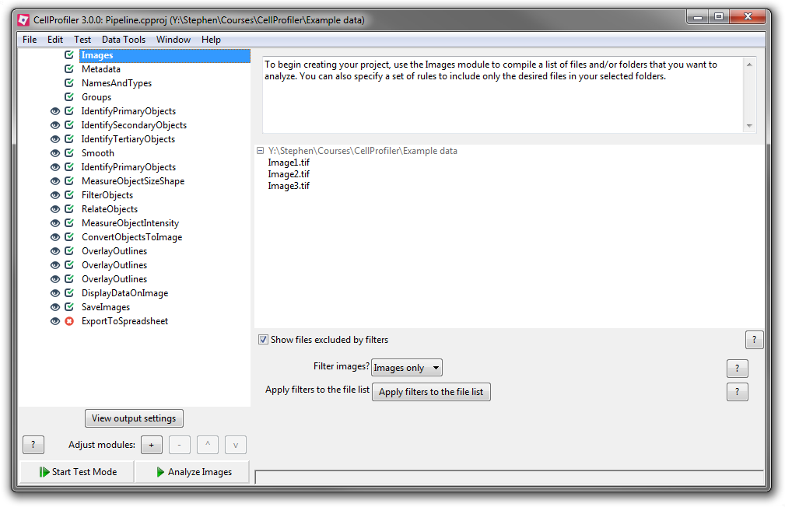
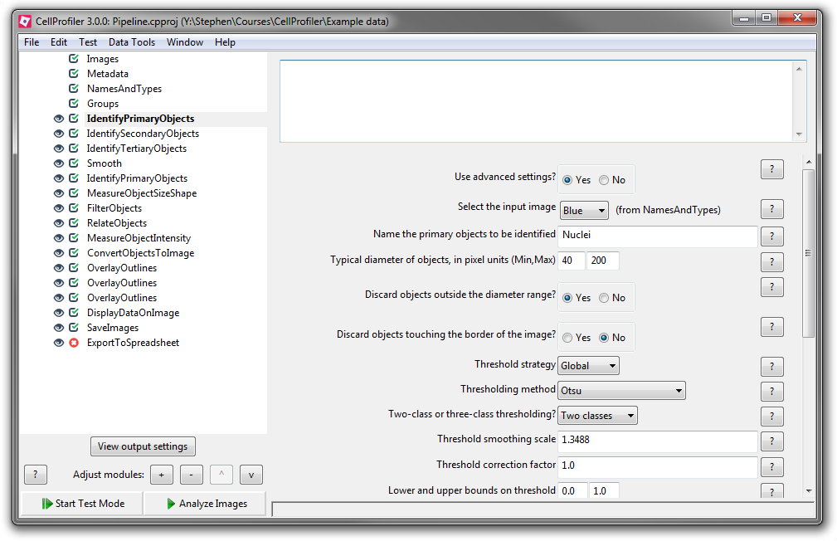
CellProfiler interface
Enable/disable visualisation
Module status
Compulsory modules
Module notes
List of modules
Optional modules
Module parameters
Parameter help
Current module help
Enter “test mode”
Run full analysis

Slide 9
Live demo
Notes:
45 minutes
Wait 10 minutes
16:40

Slide 10
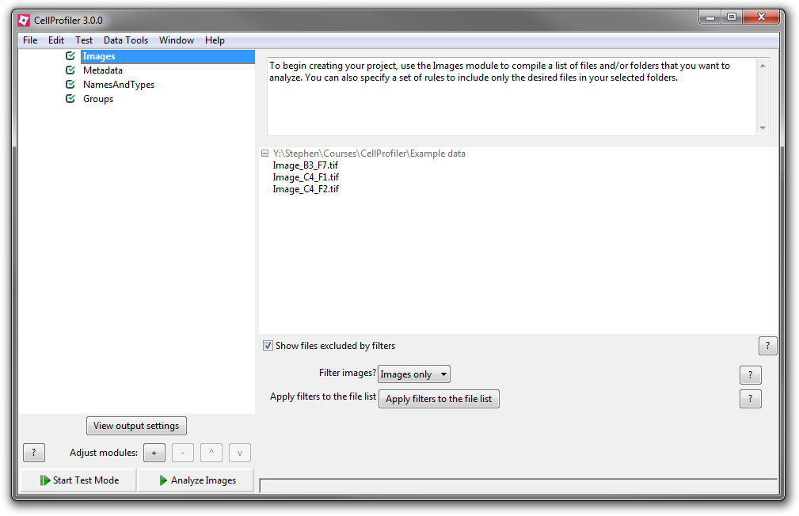
Image loading
Adding files
Right click “Drop files and folders here”, then “Browse for images”
File filters
Images only
Specific file extensions
Names including specific text
Names matching patterns

Slide 11
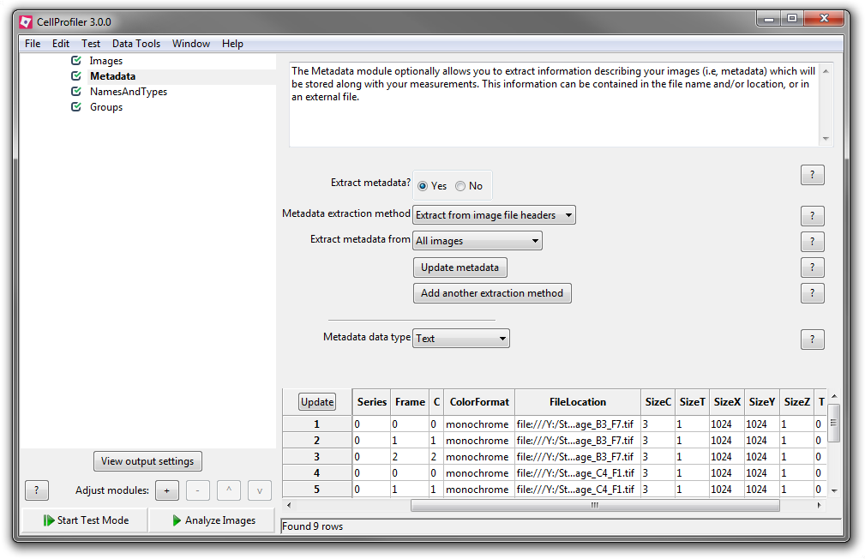
Metadata
What is metadata?
Information describing the image
Examples: number of channels, well name, spatial calibration
Where’s this info stored?
Separate file
File header
Encoded at the start of the file
File name
Name written using specific pattern

Slide 12
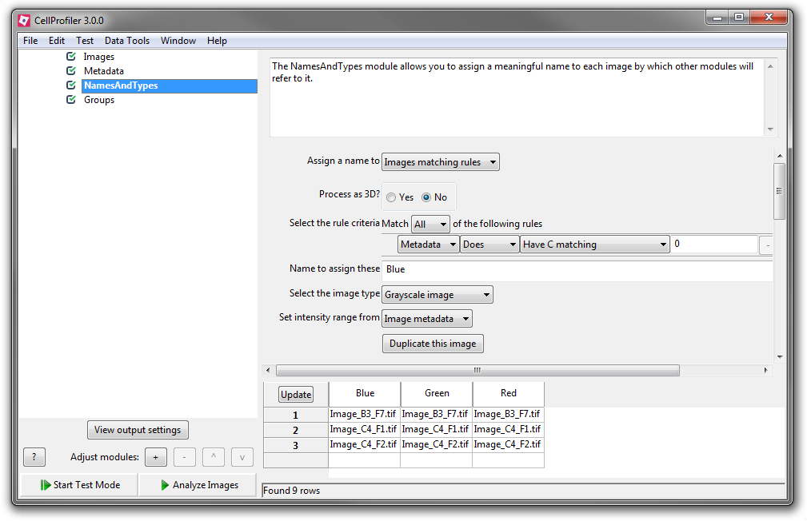
Names and types
Group files by metadata value
Assign each group a name
Groups can be processed differently
For example, our three channel test image
Group 1: nuclear stain (“Blue”)
Group 2: actin stain (“Green”)
Group 3: bacteria (“Red”)

Slide 13
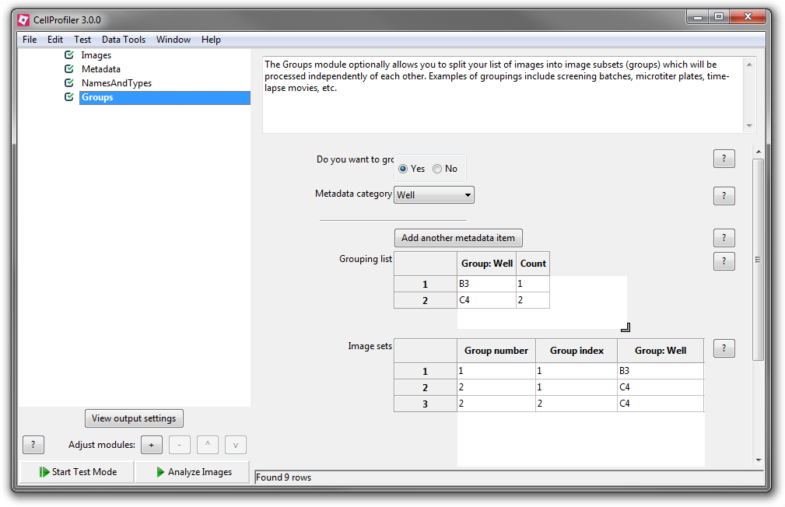
Grouping
Higher order grouping than with “names and types”
Useful for grouping by well, plate, condition, etc.
Groups will be processed separately
Can group by multiple fields

Slide 14
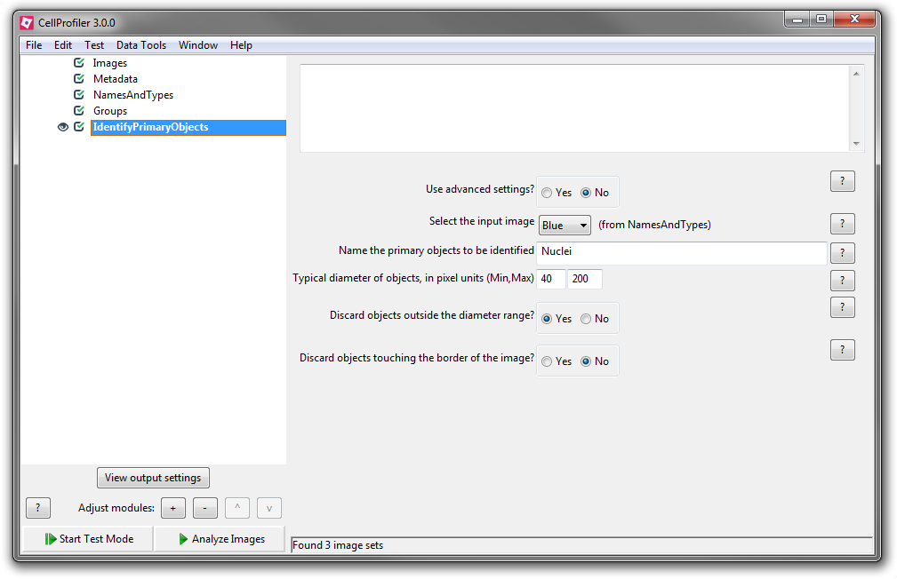
Adding modules
To add modules
Right click module area
Select module of choice
To remove modules
Highlight module
Press “Delete” on keyboard
To move modules
Drag module to new position in list

Slide 15
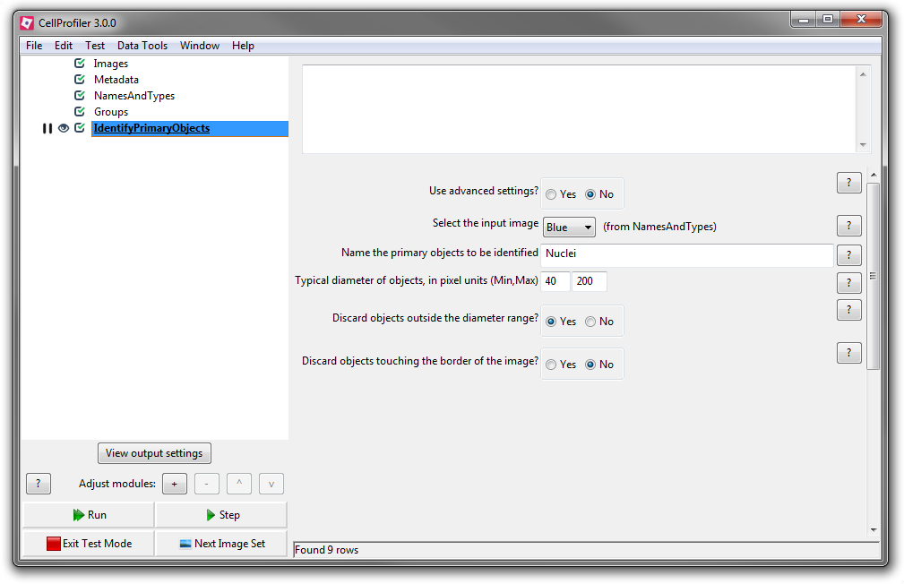
Test mode
Test mode allows each module to be evaluated on its own
Useful for testing parameters
To use test mode
Click “Test mode”
Sequentially evaluate each module by clicking “Step”
When a module is changed, the current position will return here

Slide 16
Worksheet section 1
File loading
Notes:
45 minutes
Wait 10 minutes
16:40

Slide 17
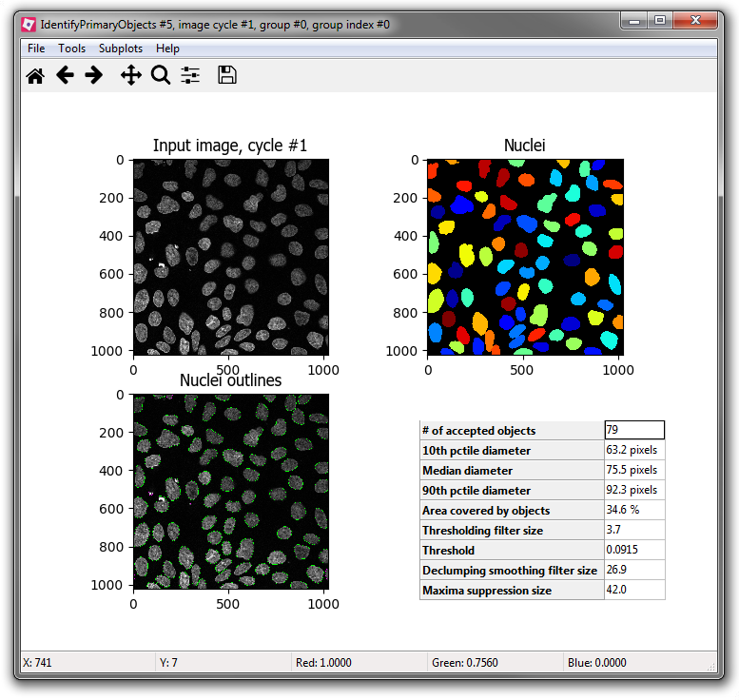
Identify primary objects
Objects that are typically isolated
Found by applying an intensity threshold and identifying contiguous regions
Don’t require a marker to assist localisation
Can refine identification
Size filters
Watershed segmentation (object splitting)
Examples of primary objects:
Nuclei, bacteria, cilia
Notes:
Live: Show detection using basic settings – which looks poor, then switch to advanced settings

Slide 18
Identify primary objects
Typical diameter of objects (size filter)
Threshold strategy (global or “adaptive”)
Thresholding method (Otsu, etc.)
Method-specific parameters will be shown
Method to distinguish clumps
Shape will split at necks in objects
Intensity is good for blobs/spots
Can specific minimum separation for splitting
Notes:
Live: Show detection using basic settings – which looks poor, then switch to advanced settings

Slide 19
Worksheet section 2
Identify primary objects
Notes:
45 minutes
Wait 10 minutes
16:40

Slide 20
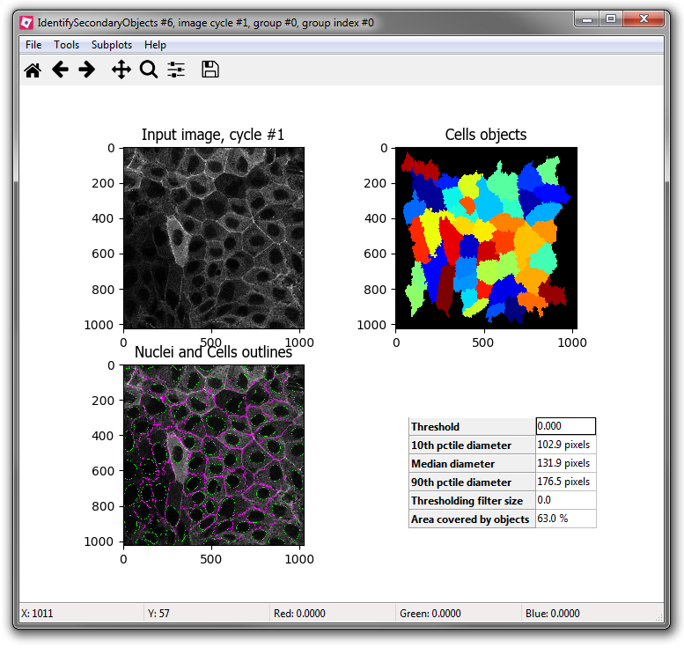
Identify secondary objects
Uses previously-identified objects as markers for detection
Many methods for detecting object edges
“Propagate” moves object boundary out from marker at constant rate
“Watershed” uses image intensity
“Distance” creates fixed range around marker
Used for detecting cells from marker nuclei
Notes:
Live: Show detection using basic settings – which looks poor, then switch to advanced settings

Slide 21
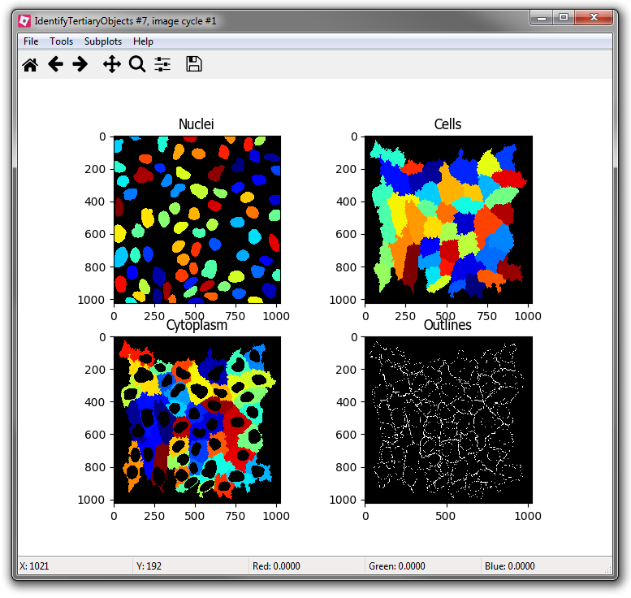
Identify tertiary objects
Creates objects from the difference between two other objects
Used for identifying cytoplasm from previously-identified cells and nuclei
Notes:
Live: Show detection using basic settings – which looks poor, then switch to advanced settings

Slide 22
Worksheet section 3
Identify secondary and tertiary objects
Notes:
45 minutes
Wait 10 minutes
16:40

Slide 23
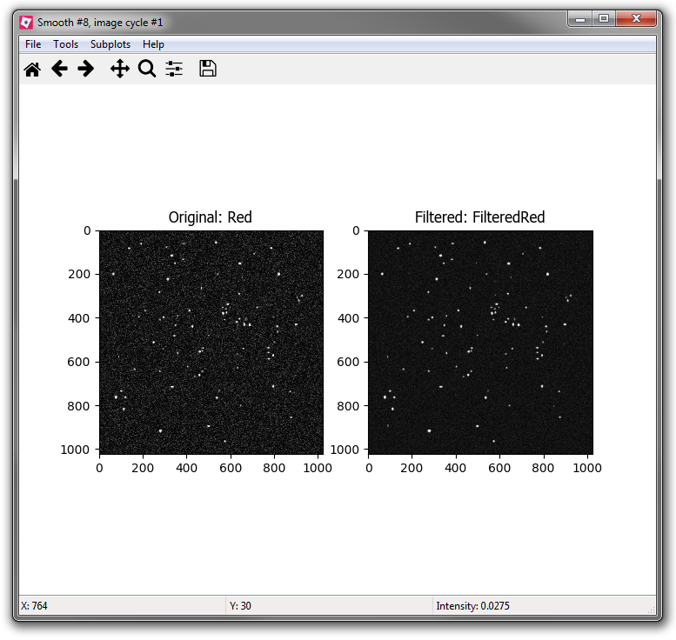
Smooth (filter) images
Apply filter to image to reduce noise
Various filters including
Polynomial, Gaussian, median, average
Automatic or manual radius calculation
Automatic is 1/40 the image size (and no more than 30 pixels)

Slide 24
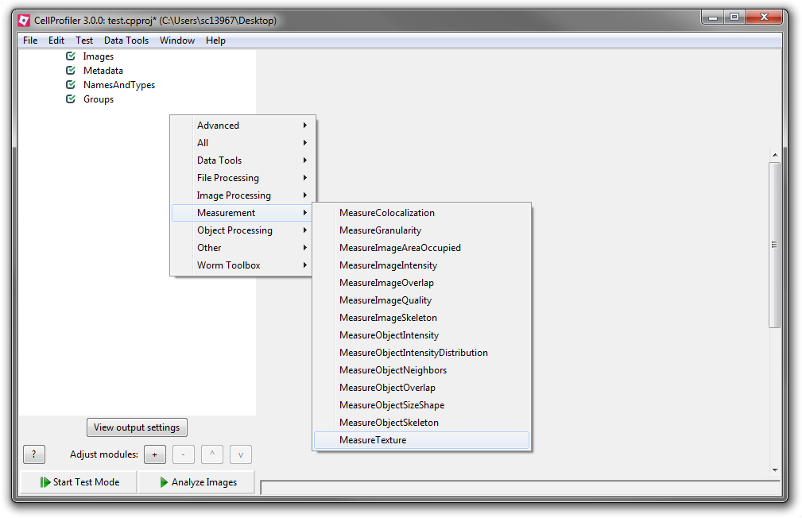
Measure image/object properties
Measure properties such as
Object size/shape
Intensity/texture (intensity values are normalised)
Colocalisation
Measurements are assigned to the image or object
Measurements can be used in subsequent modules

Slide 25
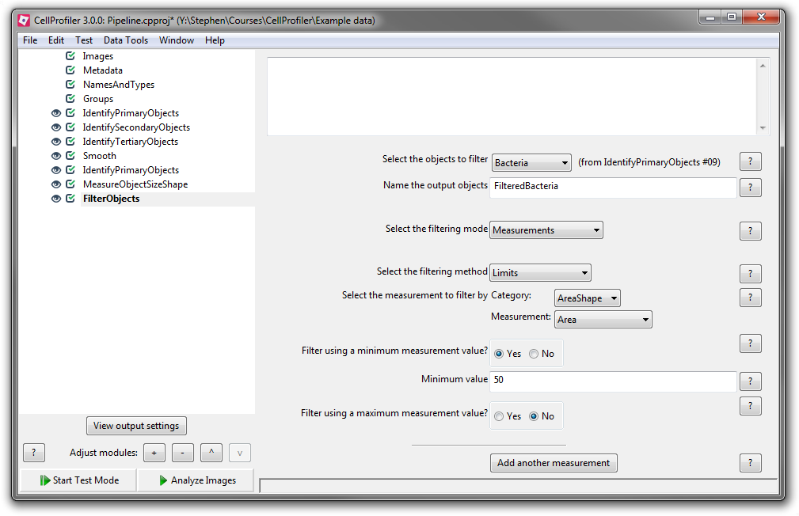
Filter objects
Remove objects based on previous measurement
Specify threshold value
Create new object for the retained objects

Slide 26
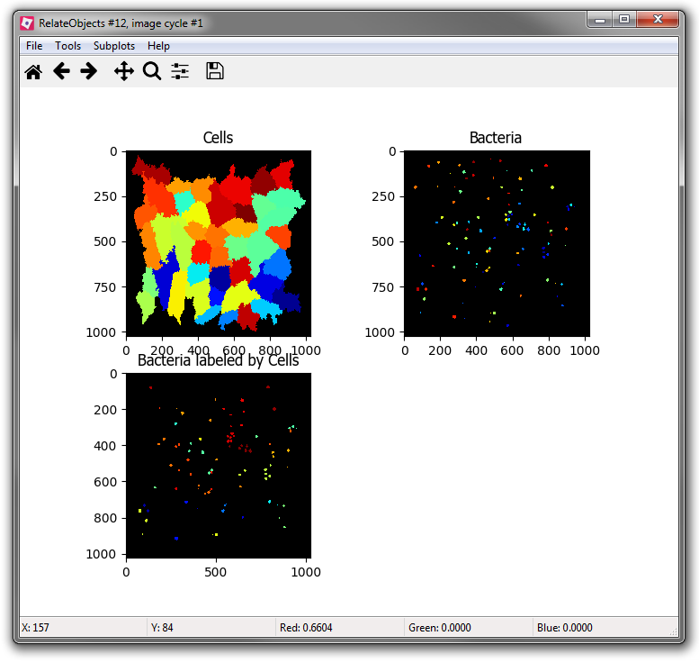
Relate objects
Assign relationships between objects based on spatial overlap
One “parent” object can have multiple “child” objects
Can calculate mean values for child object measurements

Slide 27
Worksheet section 4
Apply measurement-based object filters and relate objects
Notes:
45 minutes
Wait 10 minutes
16:40

Slide 28
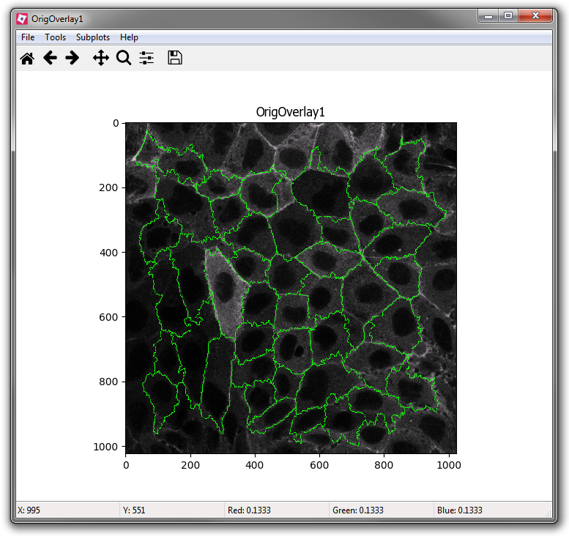
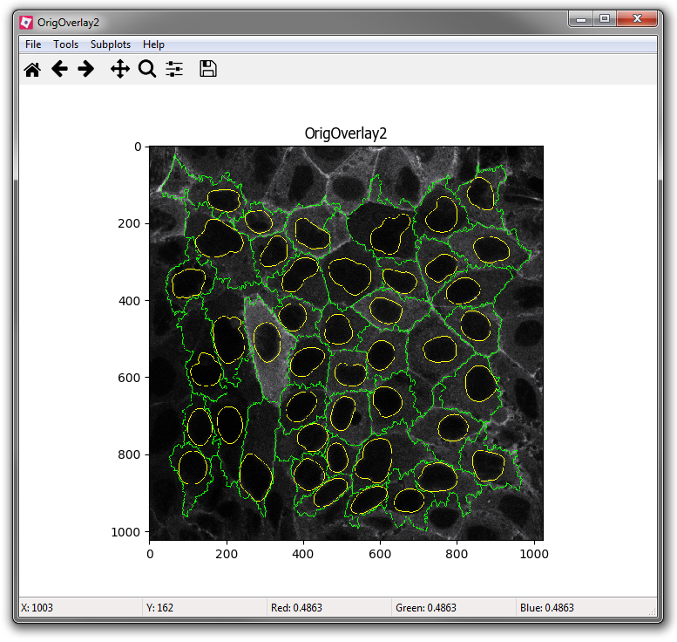

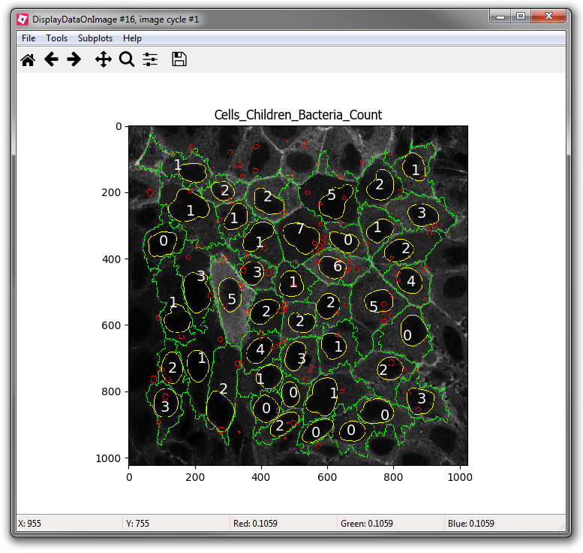
Overlay outlines / display data
Overlay outlines
Create image showing object outlines
Can display on either a blank image or other previously-loaded image
Add outlines for multiple object sets
Display data on image
Add measurement values to images
Text centred on object

Slide 29
Worksheet section 5
Visualising data
Notes:
45 minutes
Wait 10 minutes
16:40

Slide 30
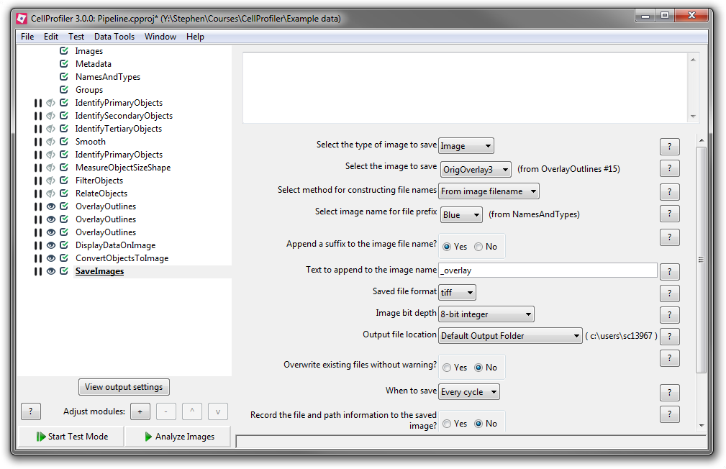
Save images
Names based on input image
Takes name from input image
Add custom suffix
Specify output location
Specific folder
Same folder as input
Default location (set via File > Preferences…)

Slide 31
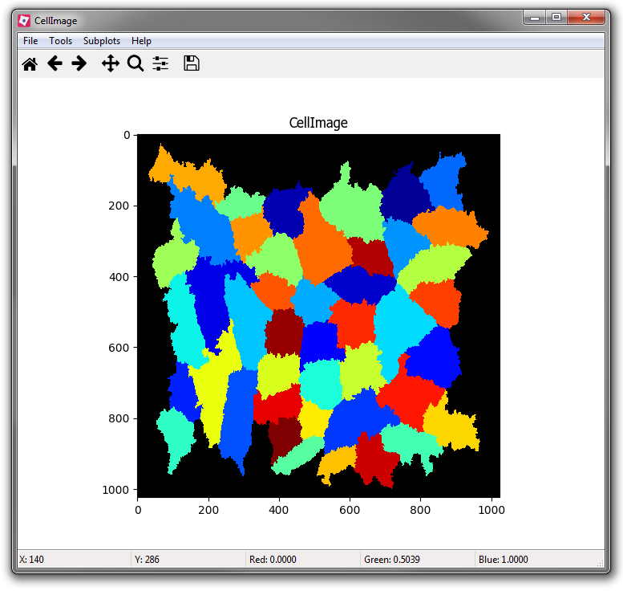
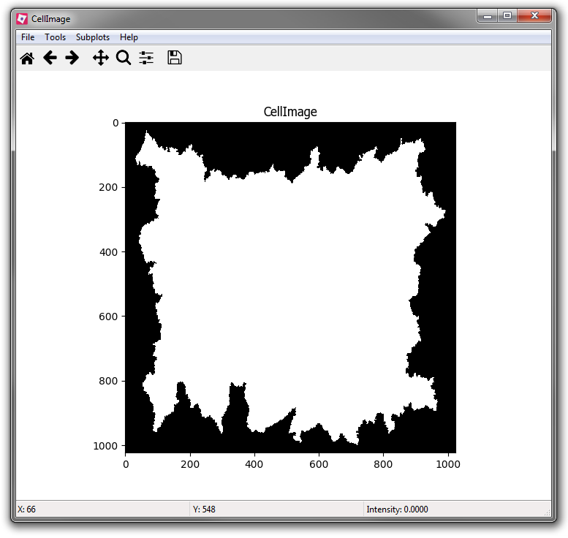
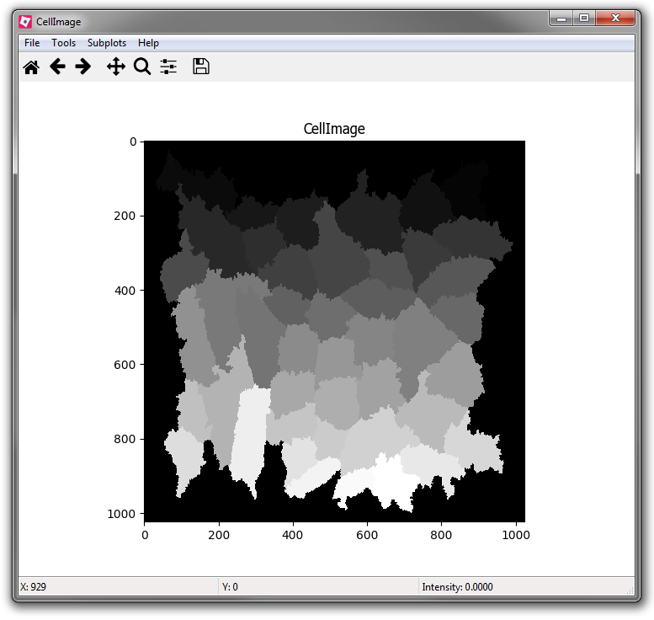
Convert objects to image
Creates a image showing objects
Option for indexed images
Intensity of each pixel corresponds to ID number of object
Color format
“Color” uses random colouring
“Binary” are black and white
“Greyscale” are indexed (up to 255 objects)
“uint16” are indexed (up to 65535 objects)

Slide 32
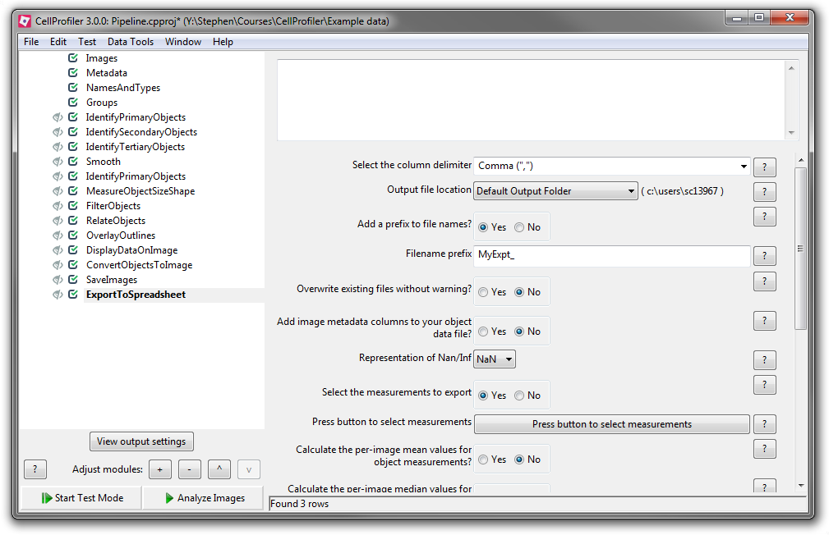
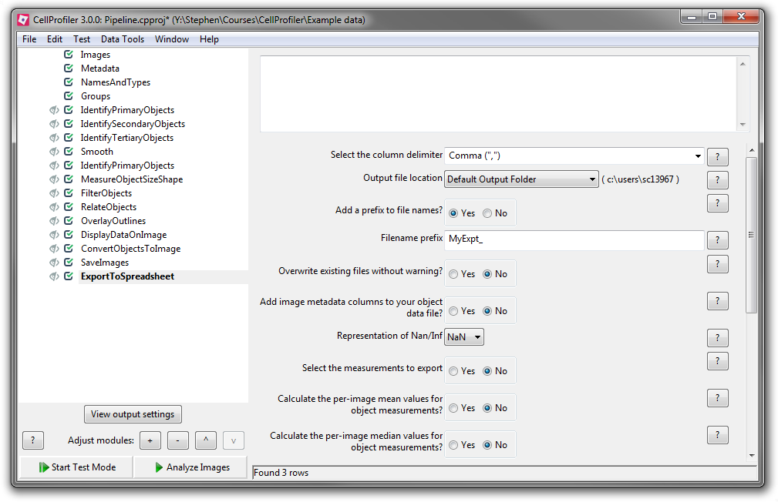
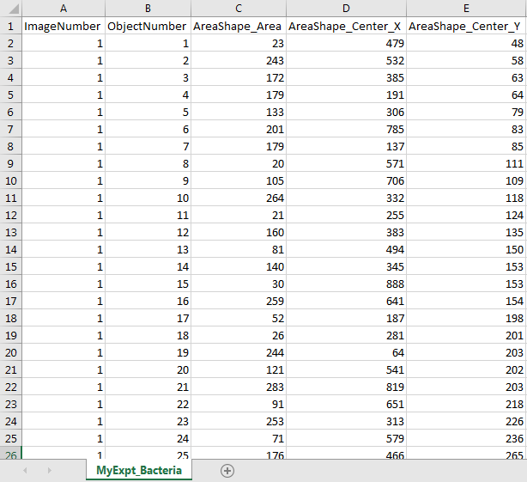
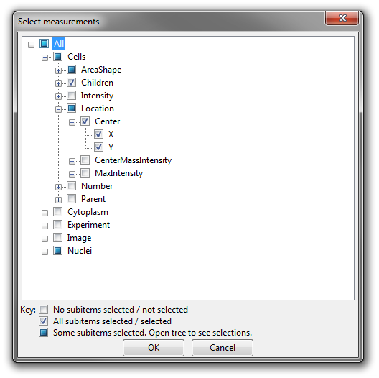
Export to spreadsheet
Multiple exported files
One per object set
Object relationships summary
Analysis pipeline summary
Can choose which to export
Specify output location
Add prefix to filename
Select measurements to export

Slide 33
Worksheet section 6
Exporting data
Notes:
45 minutes
Wait 10 minutes
16:40

Slide 34
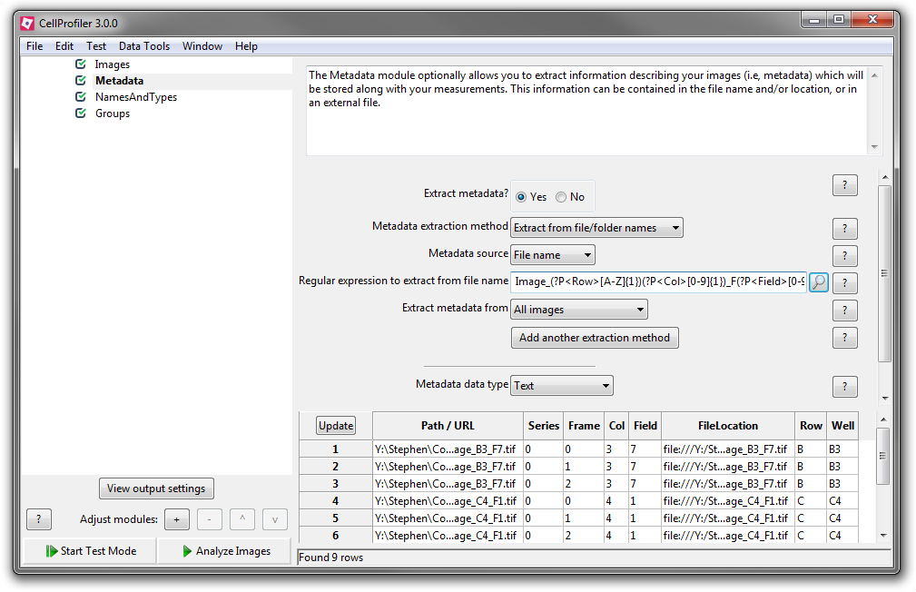
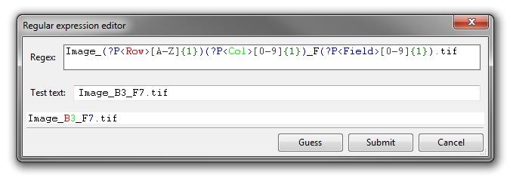
Regular expressions (Regex)
Filenames have specific pattern
e.g. “Image_B3_F1.tif” is “[Name]_[Well]_[Field].tif”
Regex extracts this information
Assign regions of name to different metadata values
CP has a handy regex editor
Click the magnifying glass
Colours identified part of name

Slide 35
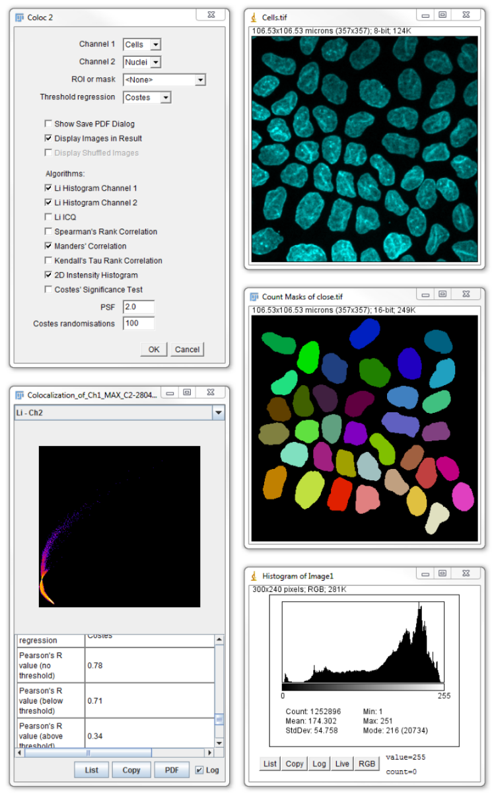
Other courses
ImageJ/Fiji Level 1
Basics of image processing and analysis
15th May 2019
ImageJ/Fiji Level 2
Automation and batch processing using macros
29th May 2018
Book via OnCourse (www.cbs-bris.org.uk)

